Slide 1
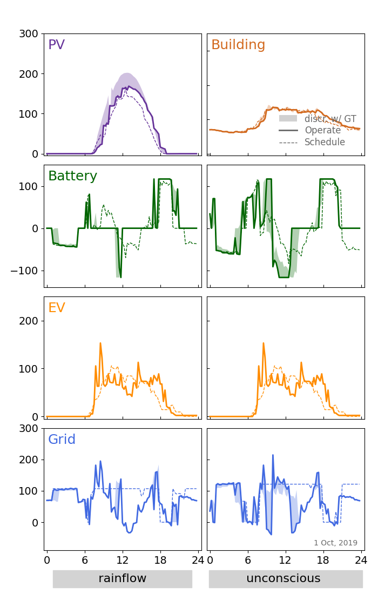
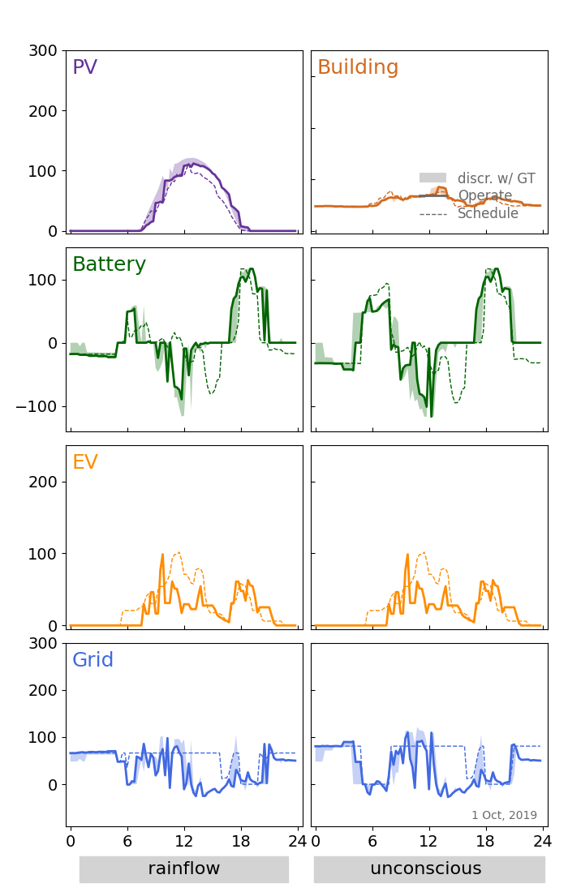
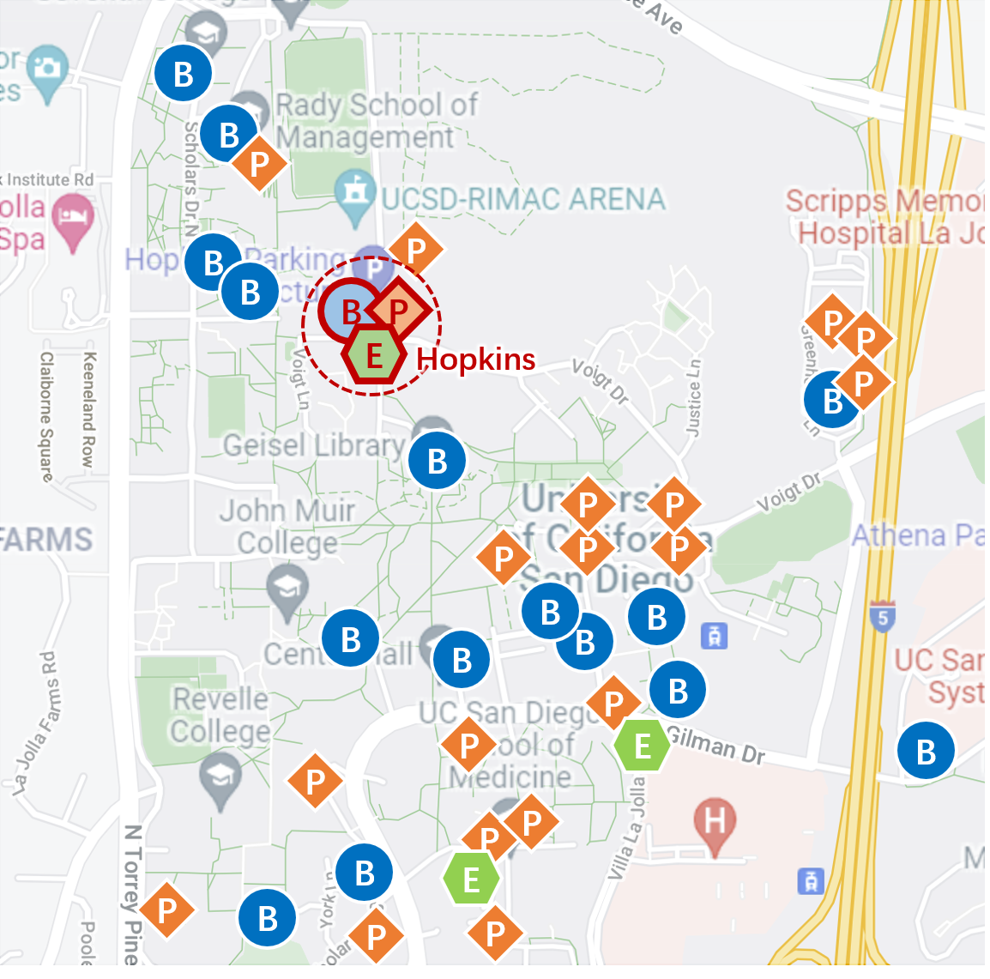
T1: Inspect whether the conclusion stands still on other bld&pv&ev combinations.
a. “standalone” buildings: Hopkins, Gilman
Gilman
Gilman
Hopkins
+ ev: Gilman | pv: Gilman
+ ev: Hopkins | pv: Hopkins
Common Params:
Strategy: MPC | ev_charge_rule: unif | p_grid_max: 1.5 | price_dc: 0.6 | price_sell: 0.6 | deg_model: DOD
Notes: MPC_GT set independently on two rows ( to ensure Pred_model is the only variable )

Slide 2
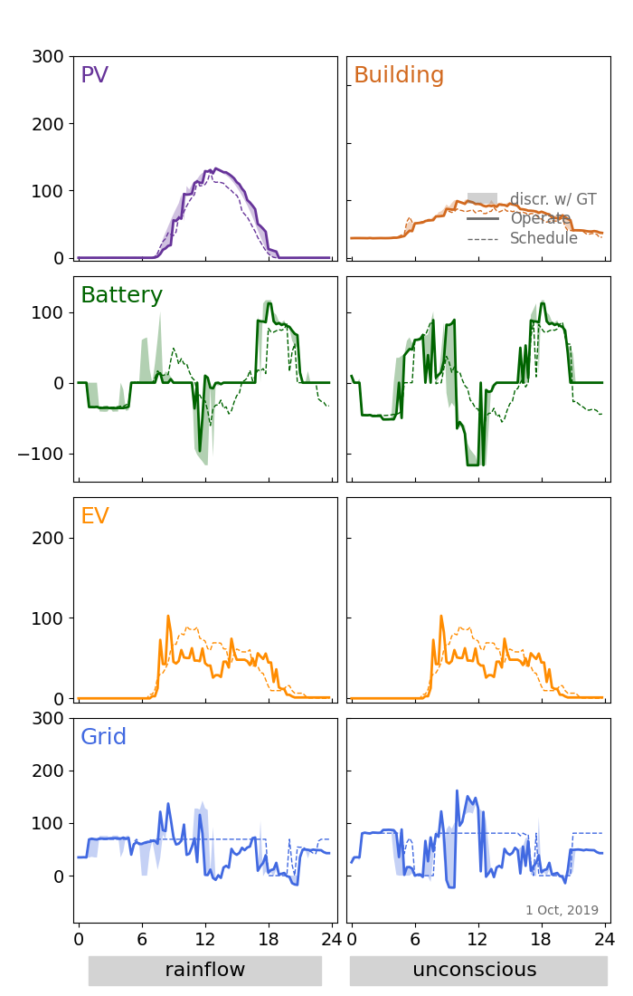
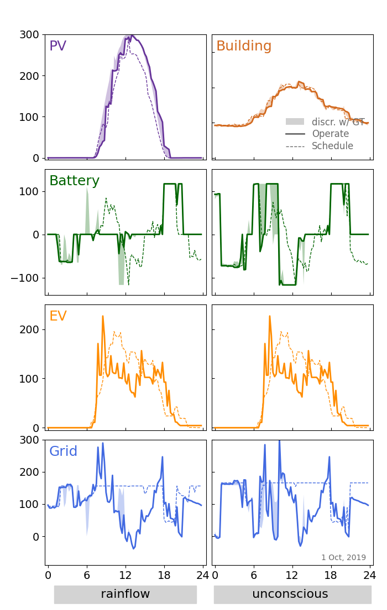
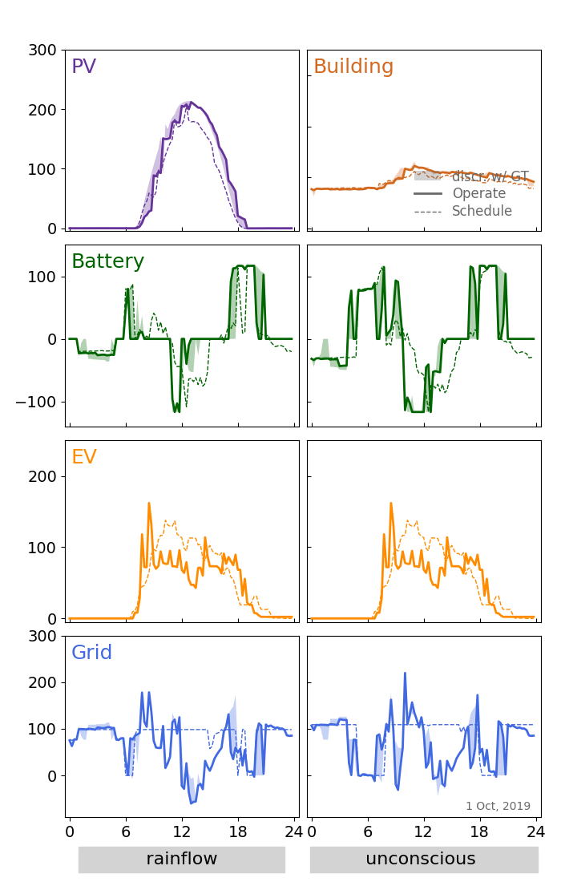
T1: Inspect whether the conclusion stands still on other bld&pv&ev combinations.
b1. adjancent to Gilman - unif
PepperCanyon
StudentService
MusicBuilding
Gilman
Pepper Canyon
Student Service
Music Building
+ ev: Gilman | pv: Gilman
Common Params:
Strategy: MPC | ev_charge_rule: unif | p_grid_max: 1.5 | price_dc: 0.6 | price_sell: 0.6 | deg_model: DOD
Notes: MPC_GT set independently on two rows ( to ensure Pred_model is the only variable )

Slide 3
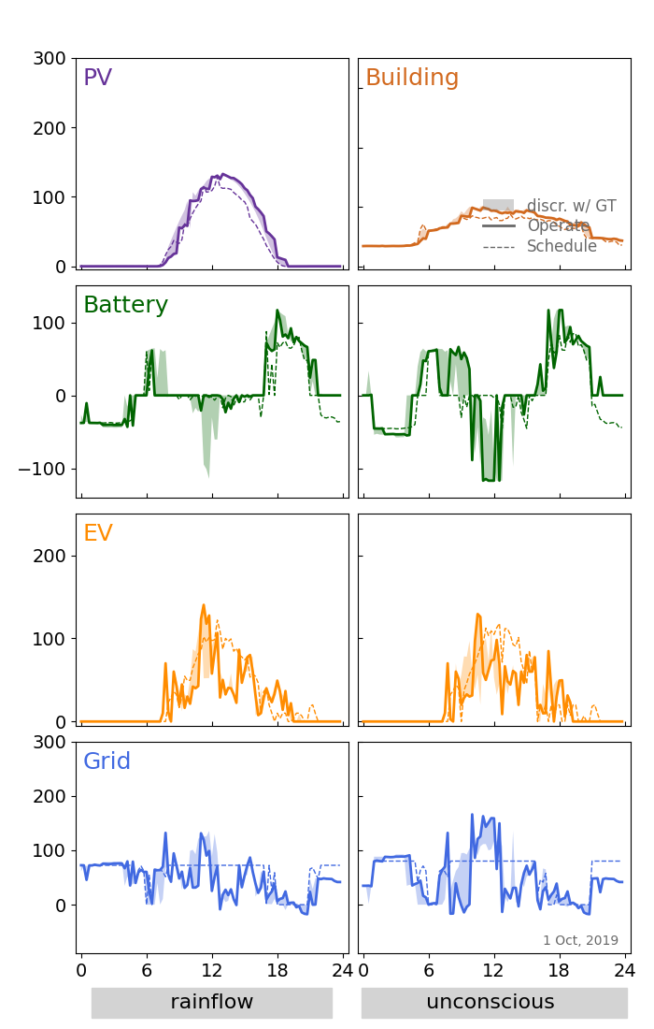
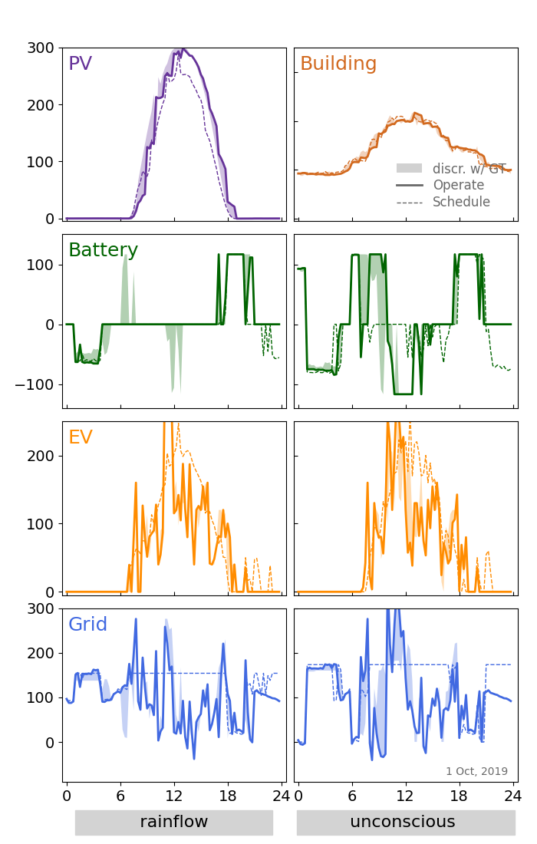
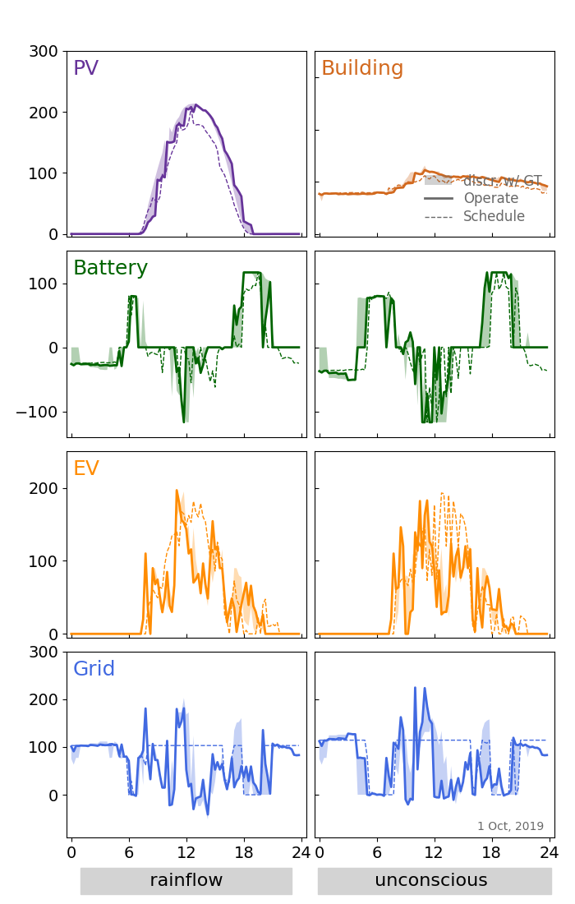
T1: Inspect whether the conclusion stands still on other bld&pv&ev combinations.
b2. adjancent to Gilman - flex
PepperCanyon
StudentService
MusicBuilding
Gilman
Pepper Canyon
Student Service
Music Building
+ ev: Gilman | pv: Gilman
Common Params:
Strategy: MPC | ev_charge_rule: flex | p_grid_max: 1.5 | price_dc: 0.6 | price_sell: 0.6 | deg_model: DOD
Notes: MPC_GT set independently on two rows ( to ensure Pred_model is the only variable )

Slide 4
Progress of Week2, July
OUTLINE
BLD&PV Load Data Selection and Synthesis
2. XGBoost Modeling
2.0 Crush Course of LSTM & XGBoost & LATEX
2.2 Input Data Encoding
2.3 Hyper Params Tuning
2.4 Forecast Performance
3. Gantt Chart

Slide 5
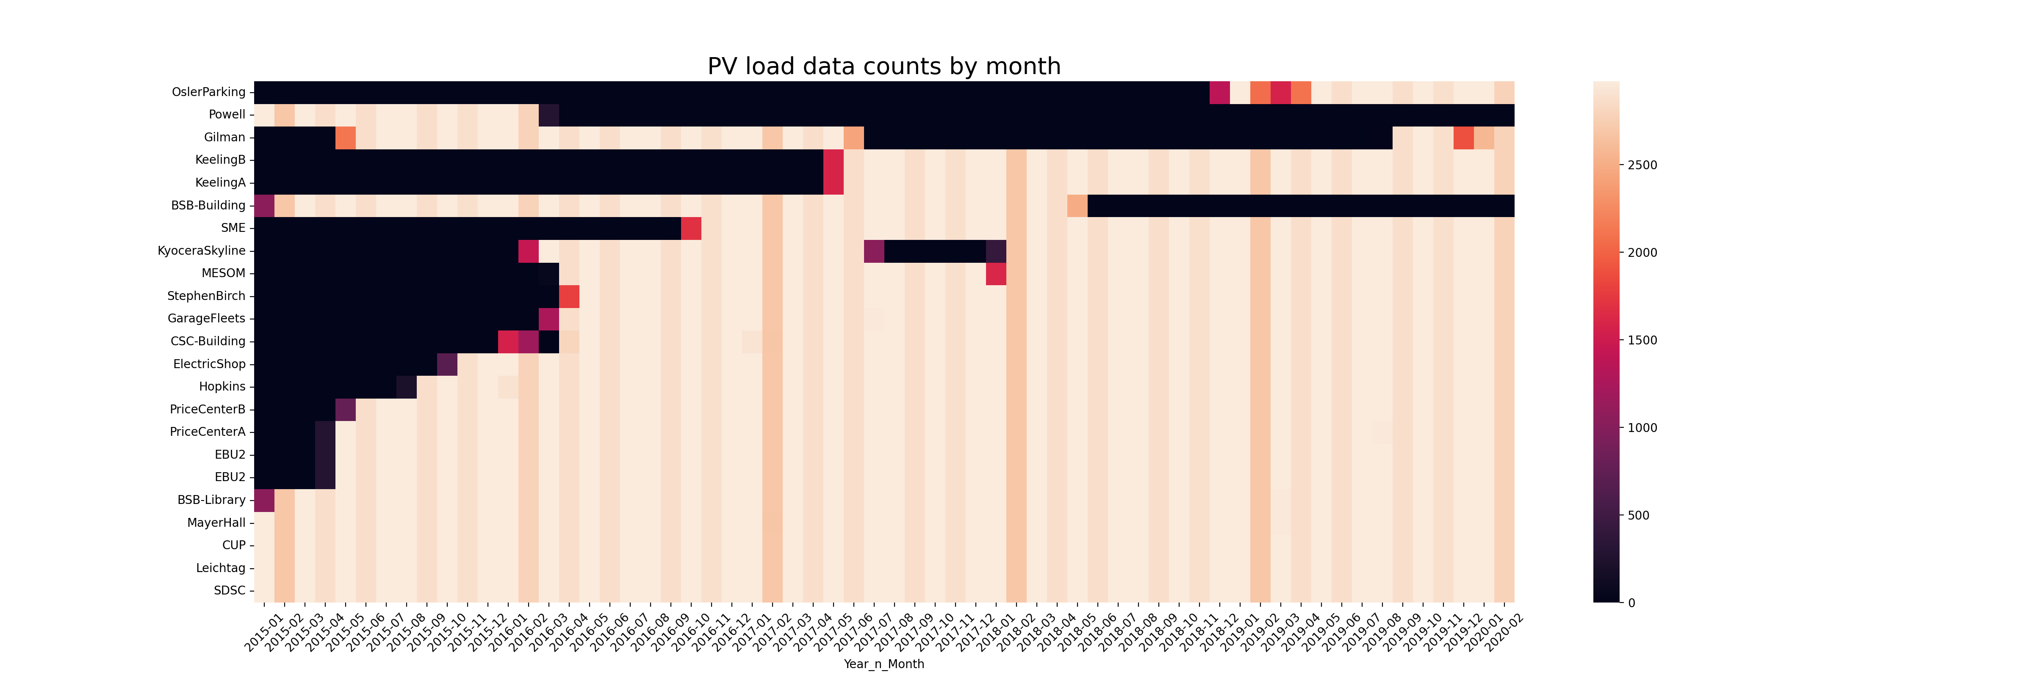
1. BLD&PV Load Data Selection and Synthesis
-1.1. PV Load Raw Data Count by Month
Max Successive
Intersection Part
Train & Test section : 2015-01 to 2018-12
Scattered NANs filled by applying linear interpolation

Slide 6
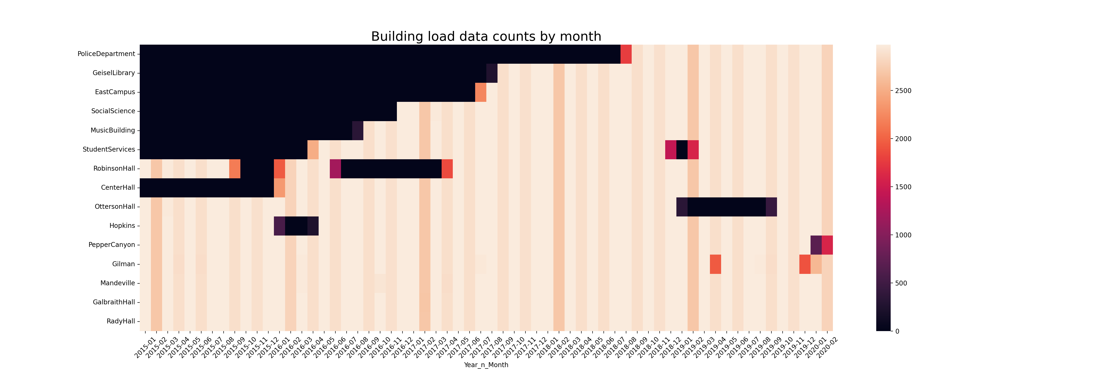
1. BLD&PV Load Data Selection and Synthesis
-1.2. BLD Load Raw Data Count by Month
10+ days’ missing
(successive)
Max Successive
Intersection Part
Train & Test section : 2015-01 to 2018-12
Scattered NANs filled by applying linear interpolation

Slide 7
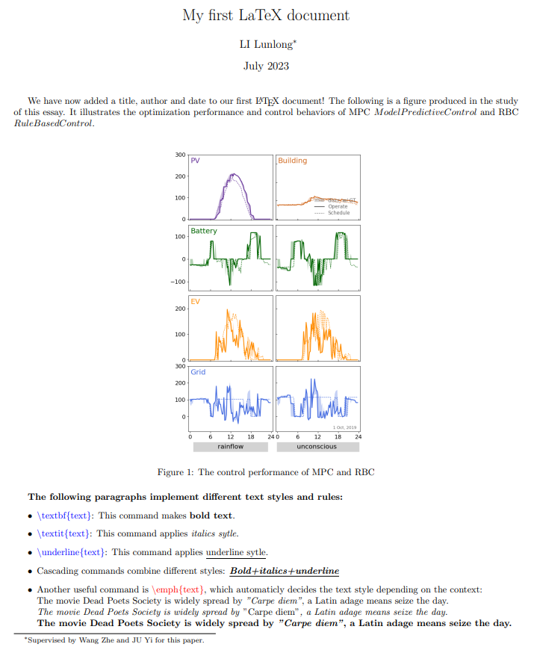
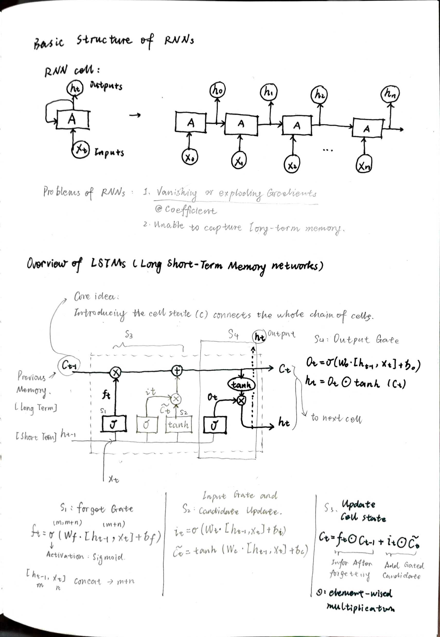
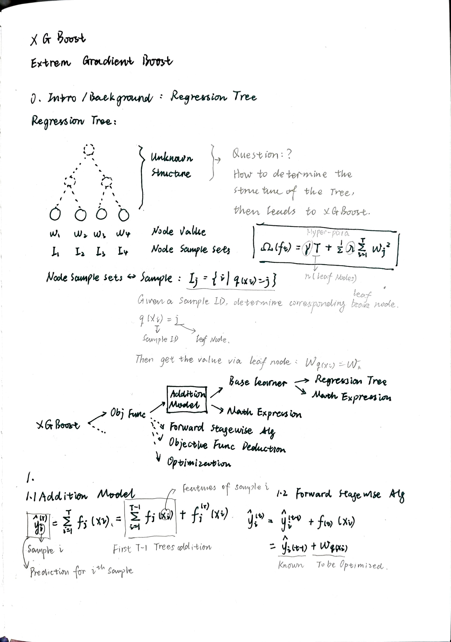
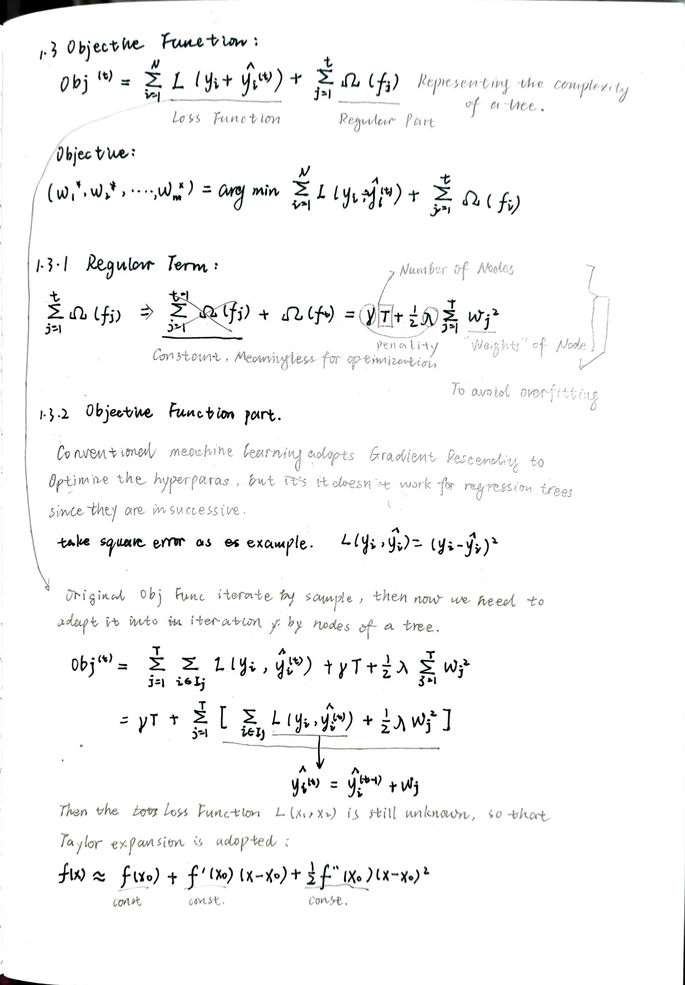
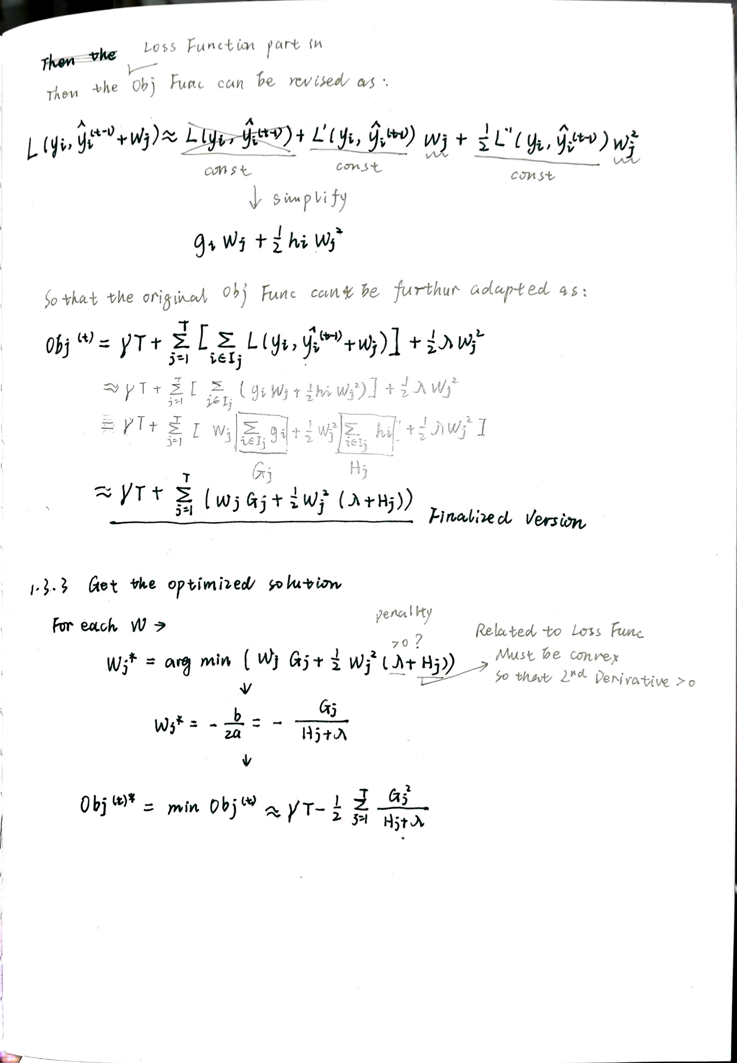
2. XGBoost Modeling
-2.0. Crush Course of LSTM & XGBoost & LATEX

Slide 8
2. XGBoost Modeling
-2.2. Input Data Encoding
Historical Feature
Time Feature
Exogenous Feature
Hour, Quarter,
Month, Year,
Dayofweek, Dayofyear, Dayofmonth
Is_holiday
Real Load：24 Steps Ahead
BLD&PV
keys -N hours Ahead: [ 'temp’:12 , 'feels_like’ ] : 12h
[ 'temp_min','temp_max', 'pressure', 'humidity’, 'wind_speed', 'wind_deg’,
'rain_1h', 'rain_3h', 'snow_1h', 'snow_3h', 'clouds_all', 'weather_main’ ] : 3h
Classification Turned into Integers

Slide 9

2. XGBoost Modeling
-2.2. Input Data Encoding – left first few values blank

Slide 10
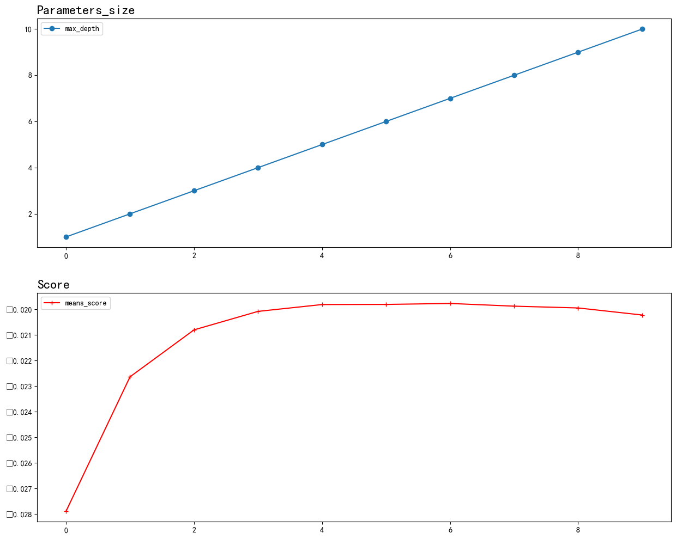
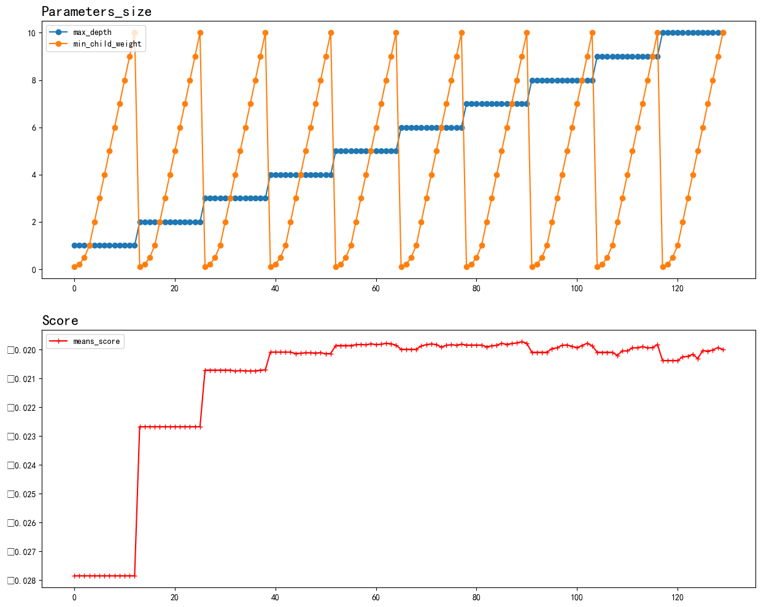
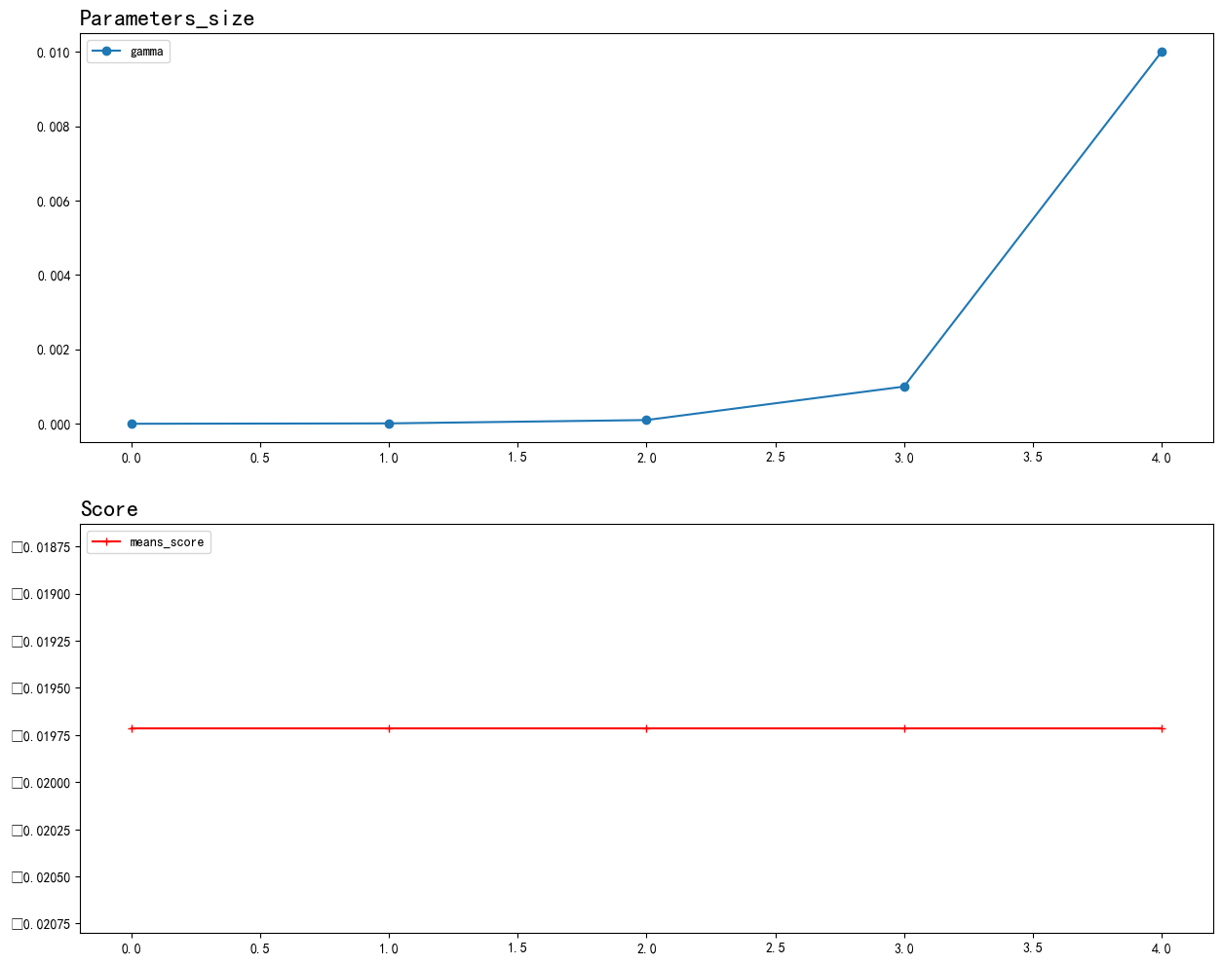
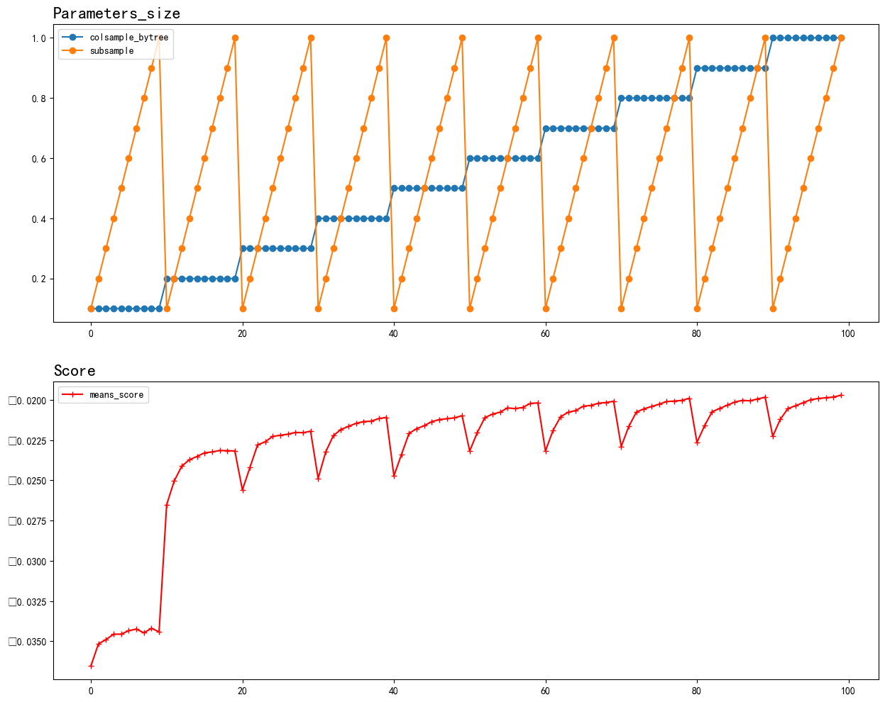
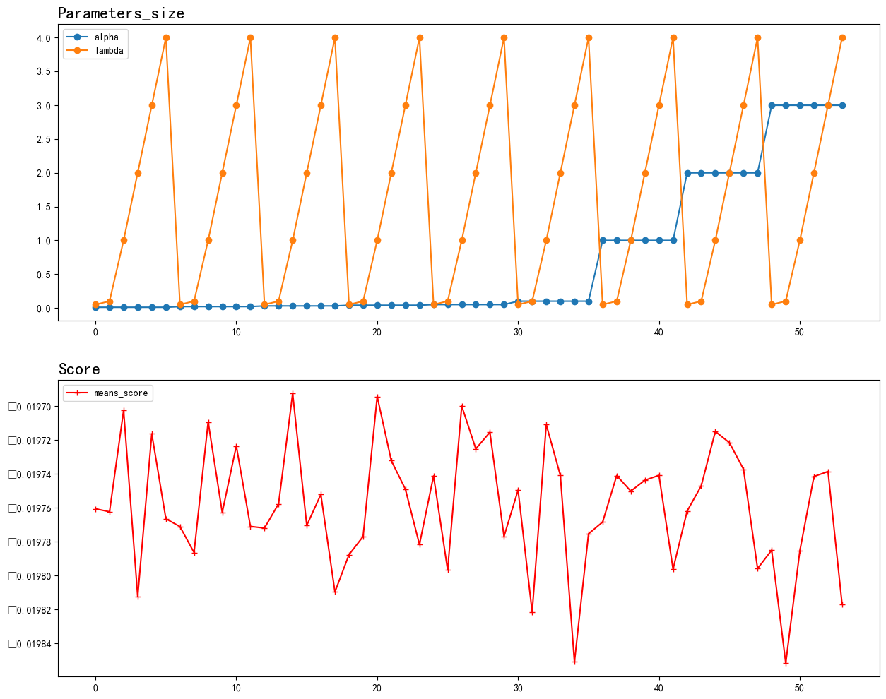
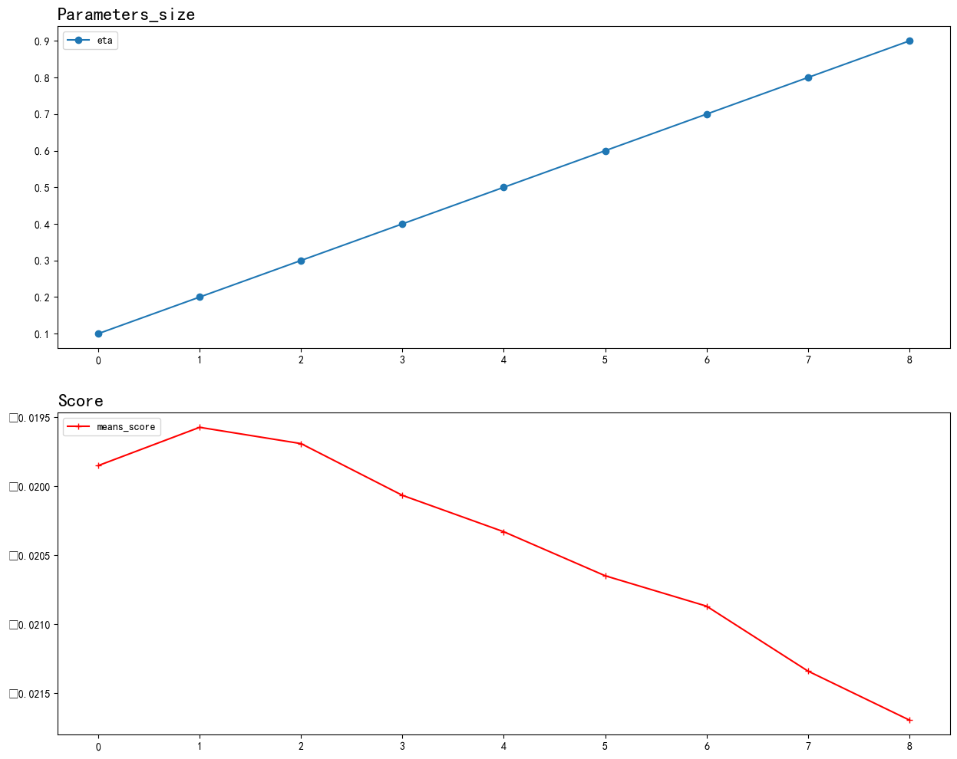
2. XGBoost Modeling
-2.2. Hyper Parameters Tuning – BLD Load – Heuristic Searching
S1
S2
Basic Settings : Train and test data={ 2015-01-01 : 2018-12-31 }
K-Fold Cross-Validation, k=6; Score-metric : MAPE
S1
'n_estimators':[10,20,30,50,80,130,210,340,550]
'max_depth': [1,2,3,4,5,6,7,8,9,10],
'min_child_weight': [60,70,80,90,100,110,120]
'gamma':[0,0.00001,0.0001,0.001,0.01]
'subsample': [0.1,0.2,0.3,0.4,0.5,0.6, 0.7, 0.8, 0.9, 1]
'colsample_bytree': [0.1,0.2,0.3,0.4,0.5,0.6, 0.7, 0.8, 0.9, 1]
'alpha': [0.01, 0.02, 0.03, 0.04, 0.05, 0.1, 1, 2, 3],
'lambda': [0.05, 0.1, 1, 2, 3, 4]
'eta':[0.1,0.2,0.3,0.4,0.5,0.6,0.7,0.8,0.9]
S3
S4
S2
S3
S4
S5
S6
S5
S6

Slide 11
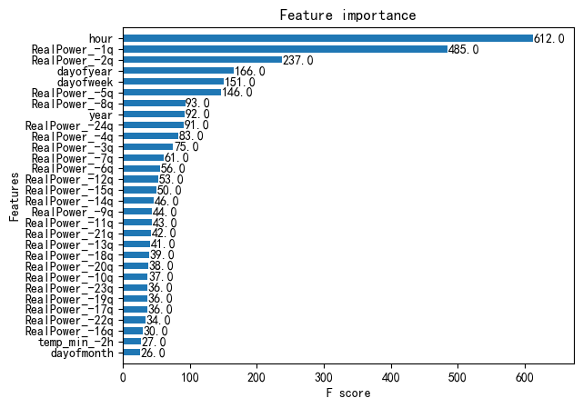
2. XGBoost Modeling
-2.2. Hyper Parameters Tuning – BLD Load – Feature Importance
Badly Depending on
Historical Real Data

Slide 12
2. XGBoost Modeling
-2.2. Hyper Parameters Tuning – PV Load – Heuristic Searching
S1
S2
Basic Settings : Train and test data={ 2015-01-01 : 2018-12-31 }
K-Fold Cross-Validation, k=6; Score-metric : MAPE
S1
'n_estimators’: [10,12,14,16,18,20,22,24,26,28,30]
'max_depth': [1,2,3,4,5,6,7,8,9,10]
'min_child_weight': [140,160,180,200,220,240,260]
'gamma':[0,0.00001,0.0001,0.001,0.01]
'subsample': [0.1,0.2,0.3,0.4,0.5,0.6, 0.7, 0.8, 0.9, 1]
'colsample_bytree': [0.1,0.2,0.3,0.4,0.5,0.6, 0.7, 0.8, 0.9, 1]
'alpha': [1.8,1.9,2,2.1,2.2,2.3,2.4]
'lambda': [0,0.01,0.02,0.03,0.04,0.05, 0.1, 1]
'eta':[0.12,0.14,0.16,0.18,0.2,0.22,0.24,0.26,0.28,0.3]
S3
S4
S2
S3
S4
S5
S6
S5
S6

Slide 13
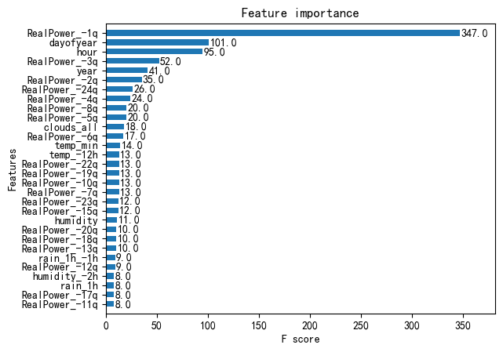
2. XGBoost Modeling
-2.2. Hyper Parameters Tuning – PV Load – Feature Importance
Still Badly Depending on
Historical Real Data
Importance Arises
Of Weather

Slide 14
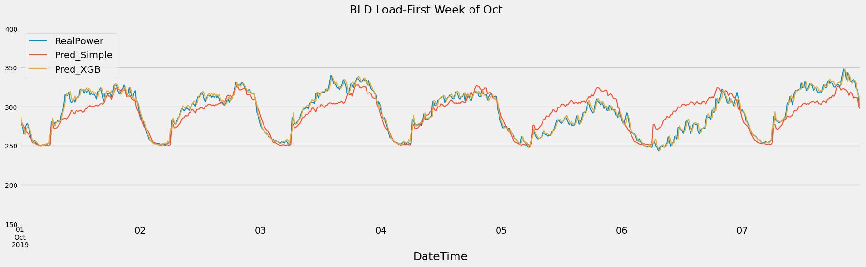
2. XGBoost Modeling
-2.3. Forecast Performance – BLD Load
Importance Arises
Of Weather
Metrics on Implementation Period: 2019-01-01 to 2019-12-31
 | MSE | MAE | MAPE
Simple | 1521.66 | 28.39 | 10.93
XGBoost | 59.63 | 5.45 | 1.96

Slide 15
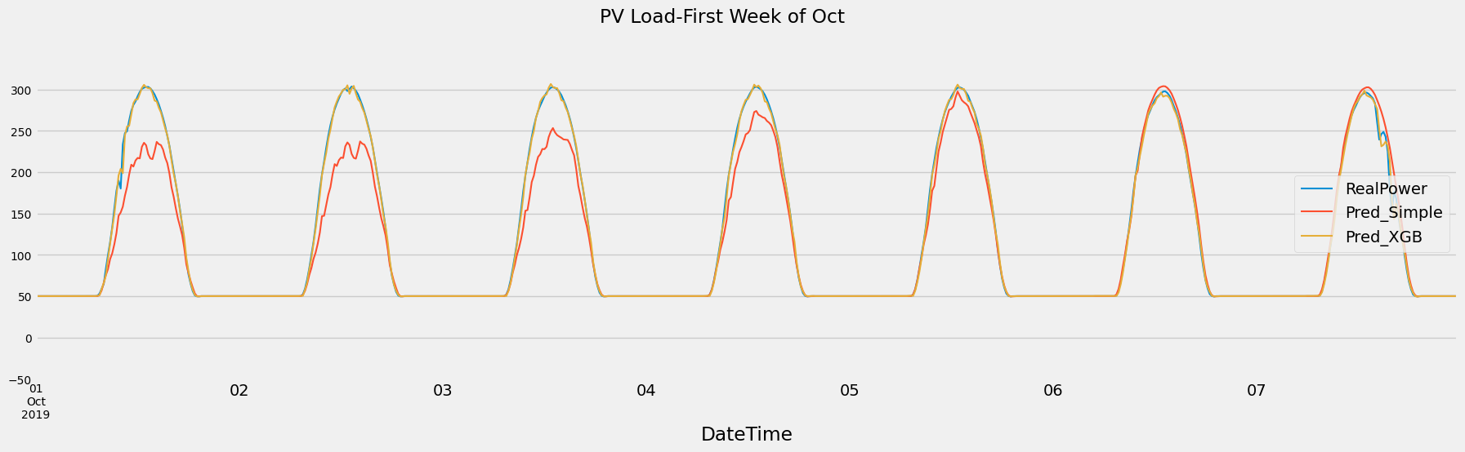
2. XGBoost Modeling
-2.3. Forecast Performance – PV Load
Importance Arises
Of Weather
Metrics on Implementation Period: 2019-01-01 to 2019-12-31
 | MSE | MAE | MAPE
Simple | 1100.34 | 15.70 | -
XGBoost | 106.36 | 4.11 | -

Slide 16
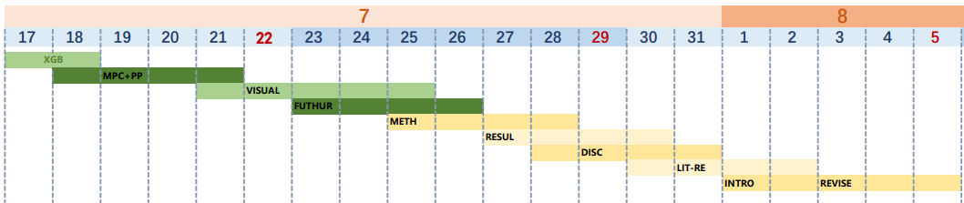
3. Gantt Chart
Intro & Abs, Draft revise
Literature Review
Discussion
Results
Methodology ( may need more time)
Future work, with simple exp and results
Visualization: Results, work&data flow, Overview of the study
Experiment: MPC with prediction, MSC
Adjusting the XGB Model

Slide 17
Progress of Week4, July
OUTLINE
Running the Experiments
1.1 Prediction setting
1.2 Visualization of Heuristic Prediction
1.3 OPEX Results

Slide 18
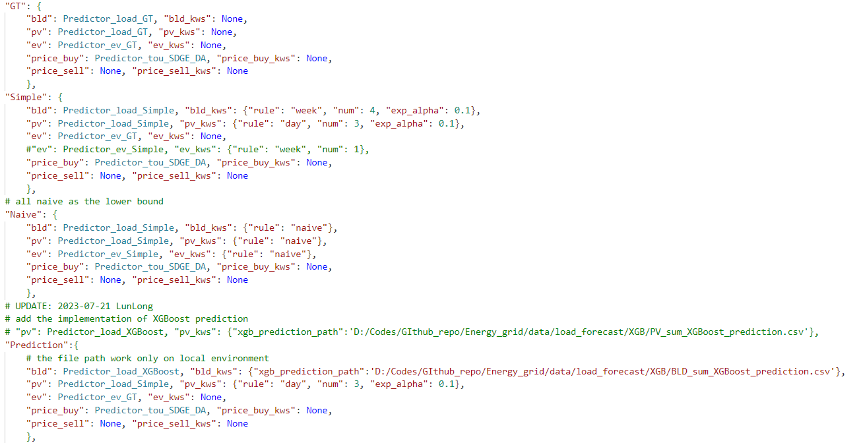
1. Running the Experiments
-1.1. Prediction setting

Slide 19
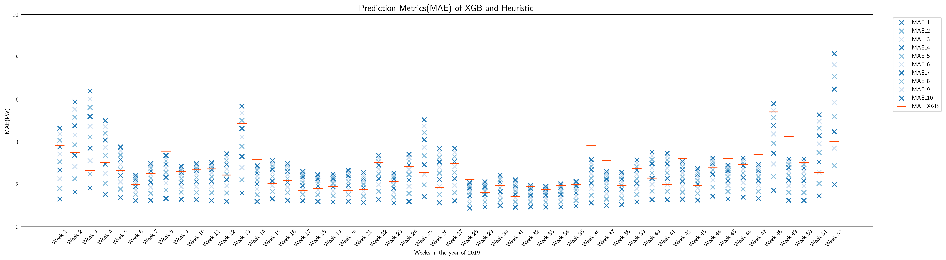
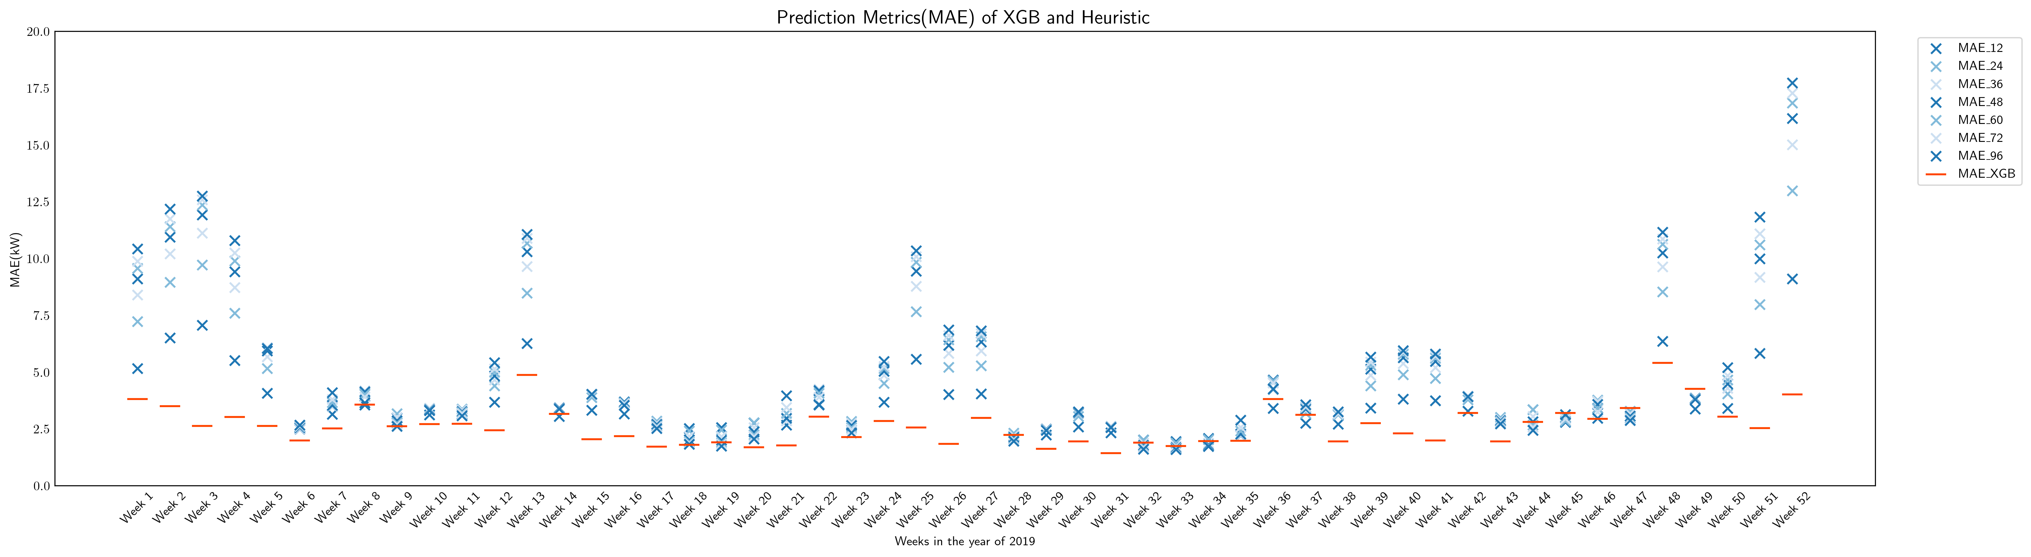
1. Running the Experiments
-1.2. Visualization of Heuristic Prediction - MAE

Slide 20
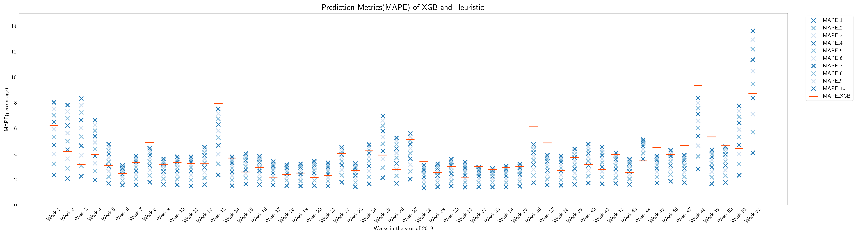
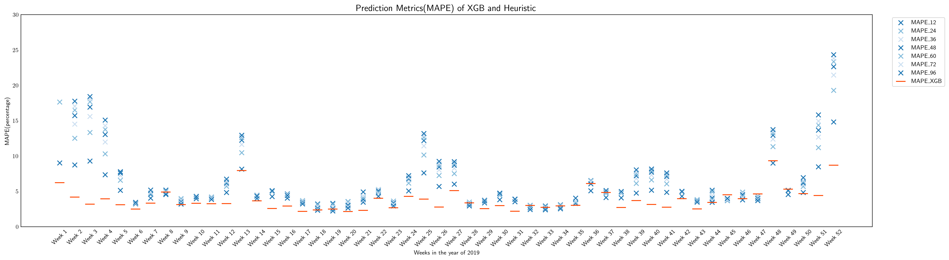
1. Running the Experiments
-1.2. Visualization of Heuristic Prediction - MAPE

Slide 21
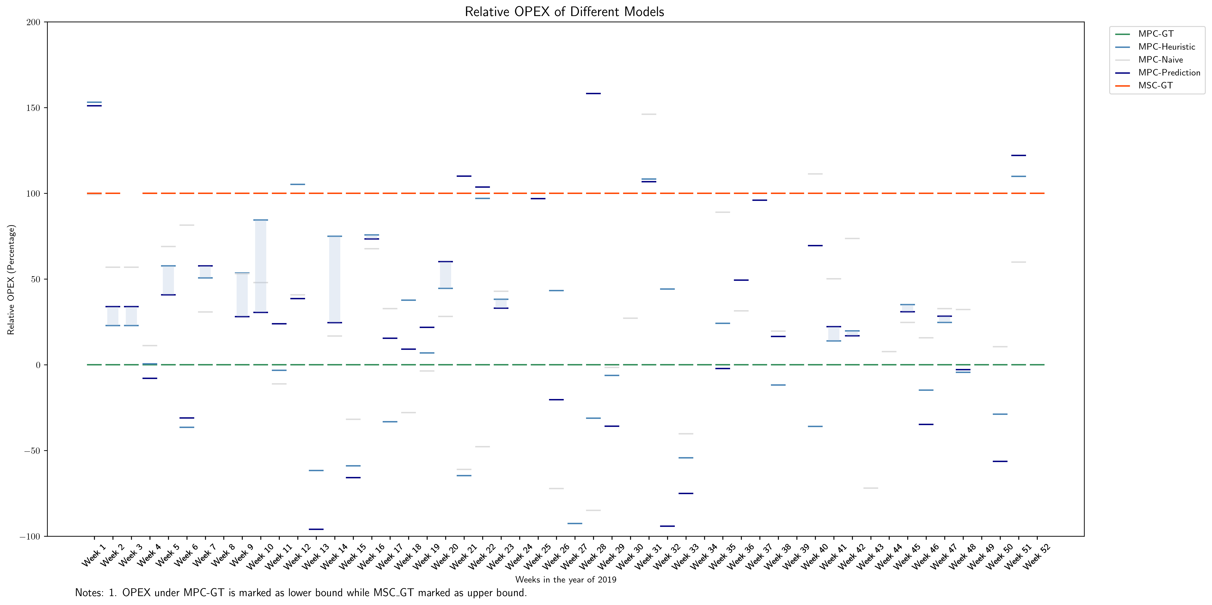
1. Running the Experiments
-1.3. OPEX Results – bat:6h

Slide 22
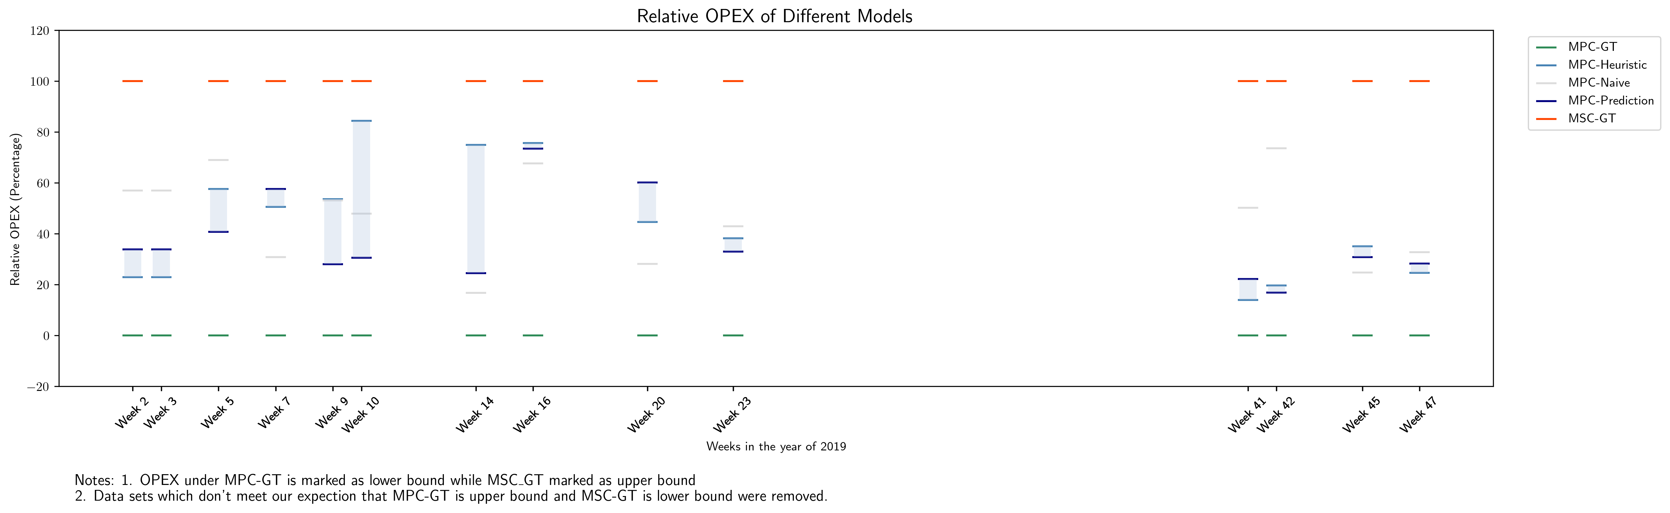
1. Running the Experiments
-1.3. OPEX Results – bat:6h

Slide 23
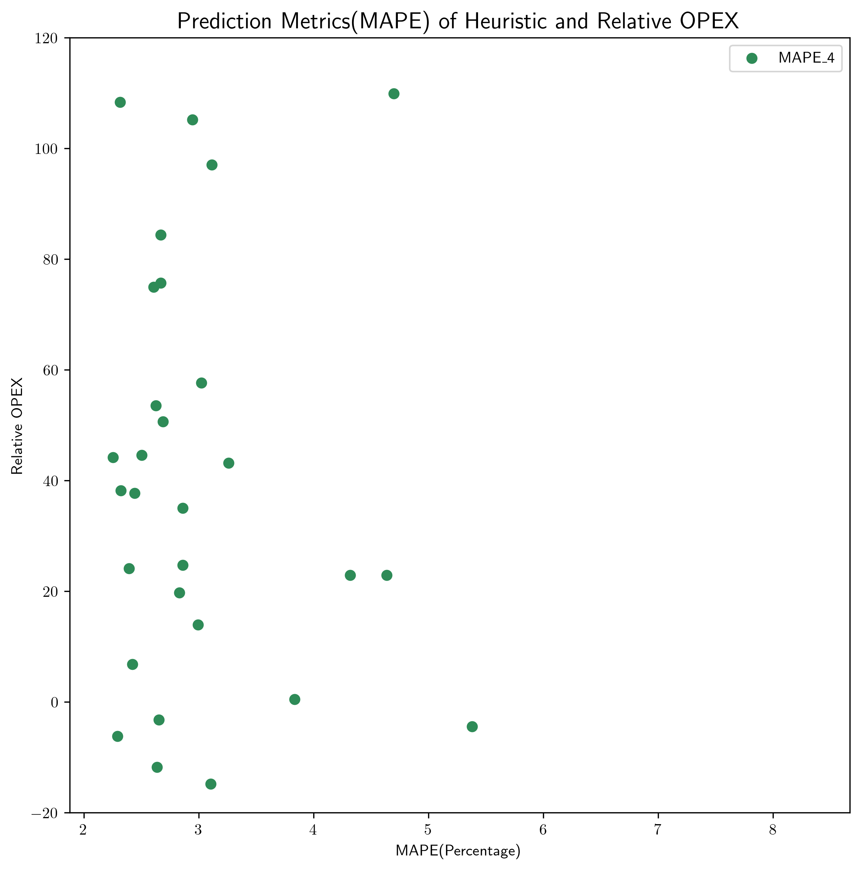
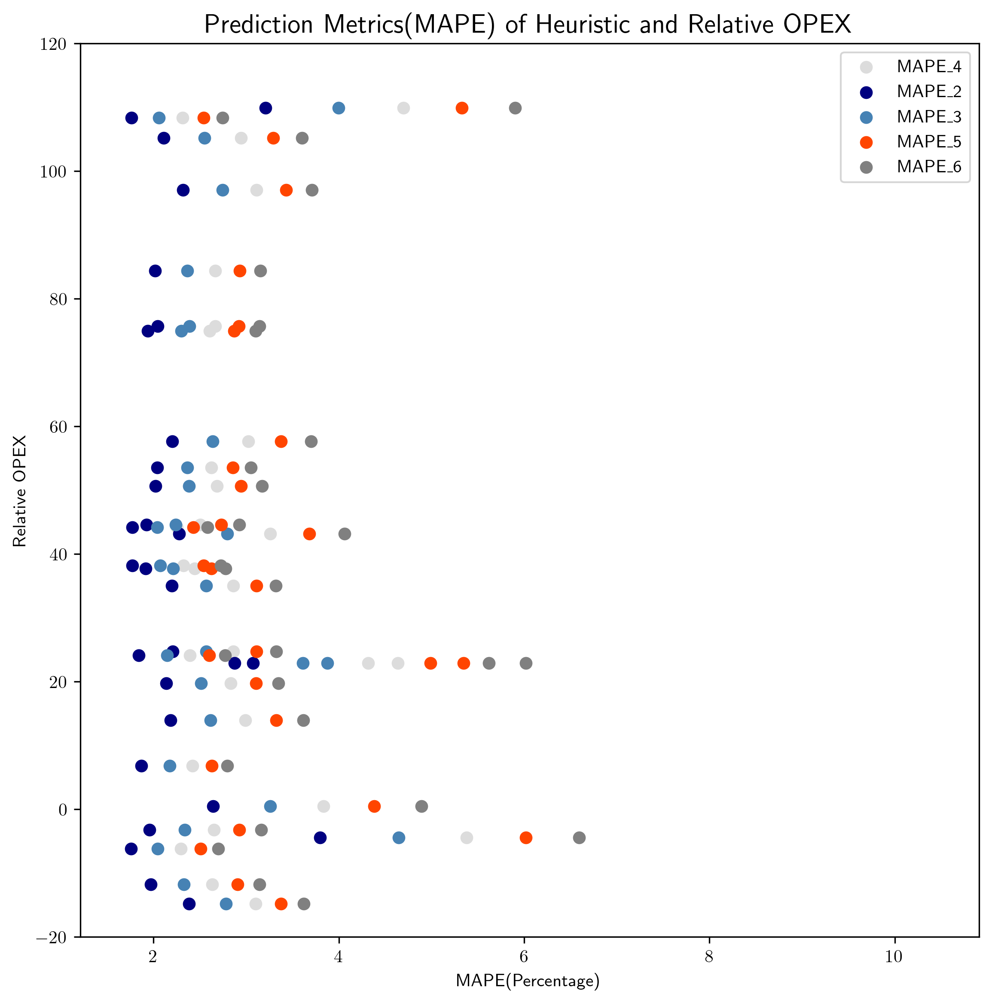
1. Running the Experiments
-1.3. OPEX Results – bat:6h

Slide 24
Progress of Week1, August
OUTLINE
How to Formulate Demand Charge
1.1 Two ways mentioned earlier
1.2 Add extra penalty – Take RBC as a base
1.3 Relate paper

Slide 25
1. How to Formulate Demand Charge
-1.1. Two ways mentioned earlier
Demand charge horizon
Way 1: Always consider the max p_grid
P_grid
Way 2: Only consider the increment of max p_grid
P_grid
MPC prediction horizon
（P.S. Shadow area means dc, overlap means repeatedly dc）

Slide 26
1. How to Formulate Demand Charge
-1.1. Two ways mentioned earlier
Demand charge horizon
Way 1: Always consider the max p_grid
Current codes
P_grid
Way 2: Only consider the increment of max p_grid
Related to add (if … else …) into gurobi constraints, which is seemingly unsupported
P_grid
MPC prediction horizon
（P.S. Shadow area means dc, overlap means repeatedly dc）

Slide 27
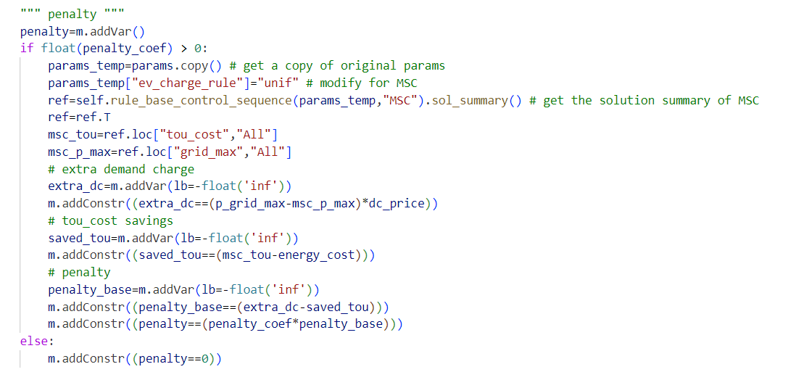
1. How to Formulate Demand Charge
-1.2 Add extra penalty – Take RBC as a base
0. Get tou_cost and p_grid_max of RBC_MSC as references
Calculate extra demand charge of MPC as extra_dc
Calculate tou_cost savings of MPC as saved_tou
Get penalty of penalty_coef * (extra_dc – saved_tou)

Slide 28
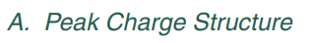
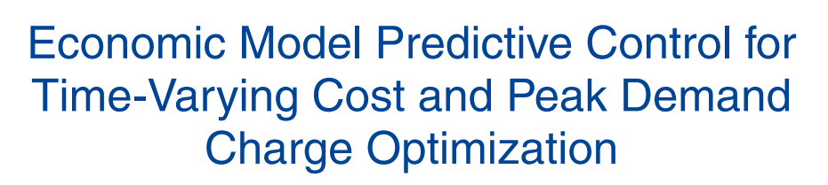
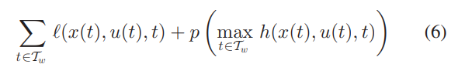
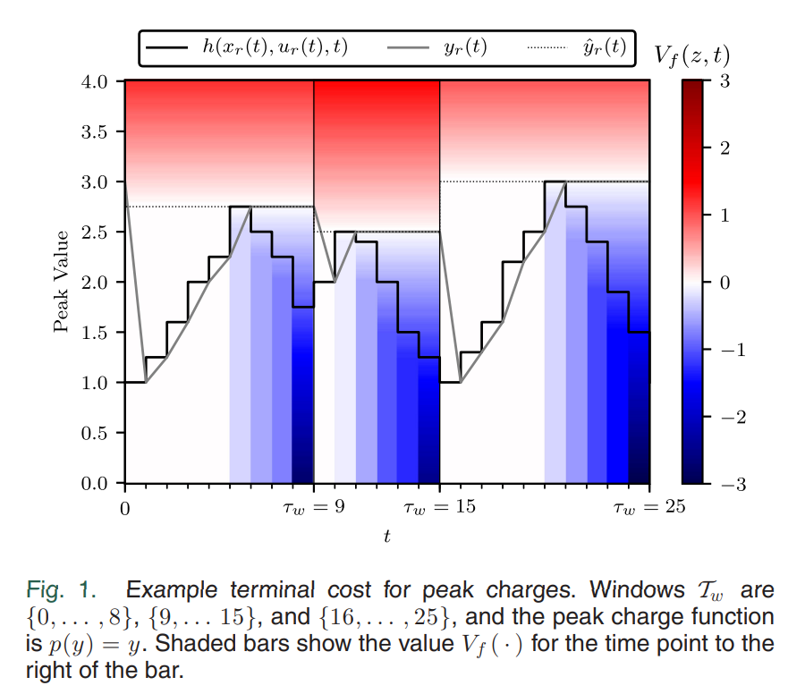
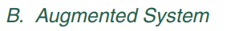
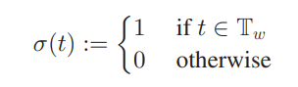
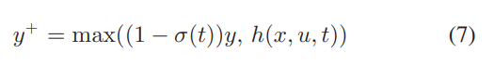
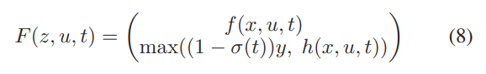
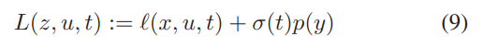
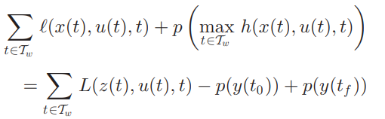
1. How to Formulate Demand Charge
-1.3 Relate paper

